Slide 1
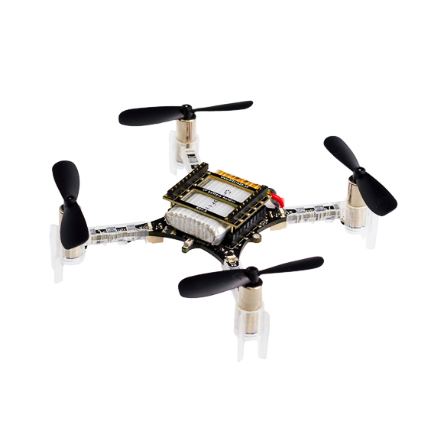
Planning and Control of a Quadrotor
EN530.678.S2021
Spring 2021
Jiahe Xu
Ray Zhang

Slide 2
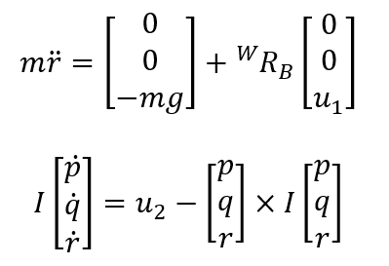
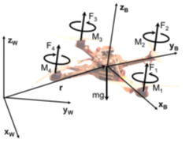
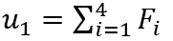
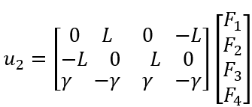
Quadrotor Model
Fi are forces produced by rotors
We directly control u1 and u2
Q

Slide 3
Our method
read the map, build the environment with small cubes
find an initial path using shortest path algorithm
use CEM method finding a better path
apply minimum jerk polynomial method producing a smooth trajectory
Q

Slide 4
We used minimum jerk segments methods to generate the trajectory.
n segments
5th order polynomials
3rd order derivatives ( minimum jerk)
Q

Slide 5
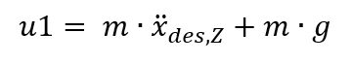
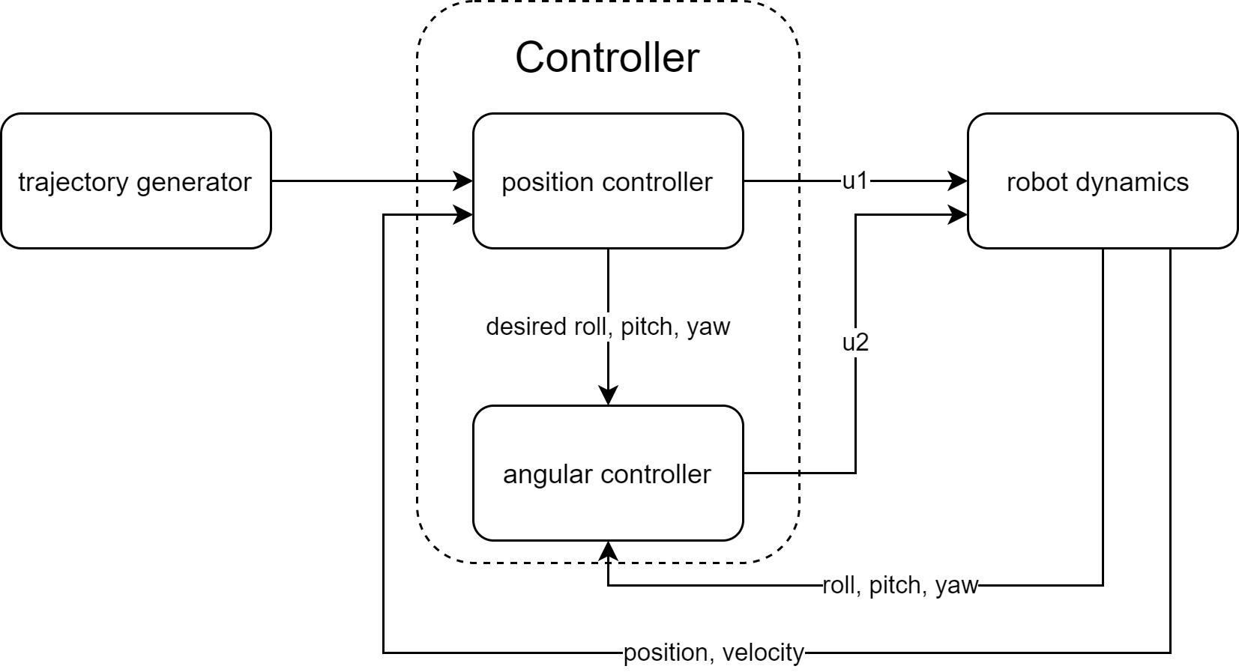
We used linear feedback control to control the quadrotor to follow the trajectory.
total motor thrust
Q
moment about the center

Slide 6
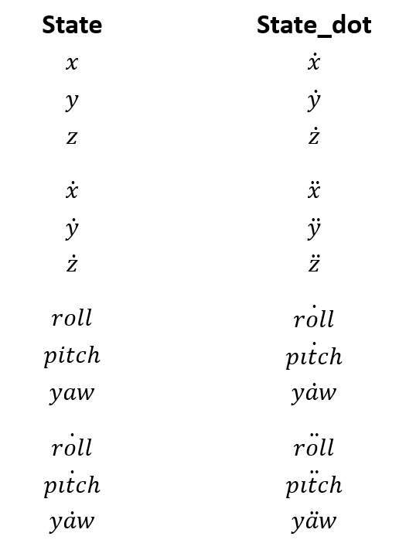
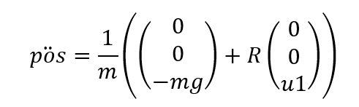
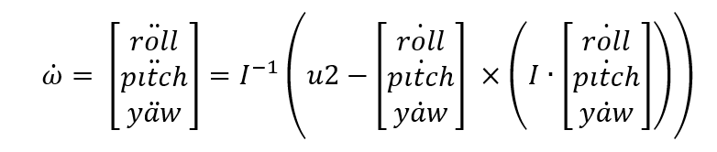
EOM takes U1 and U2 to evaluate State_dot.
Q

Slide 7
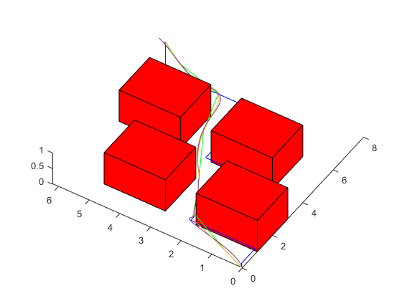
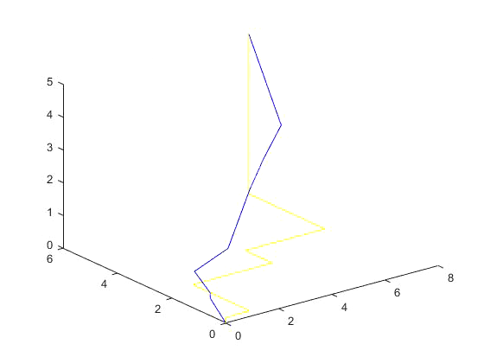
Results
theoretical shortest distance:11.05 our method: 11.24
Green: Shortest path
Yellow: Desired path
Purple: Actual path
Map1 (normal)
Q

Slide 8
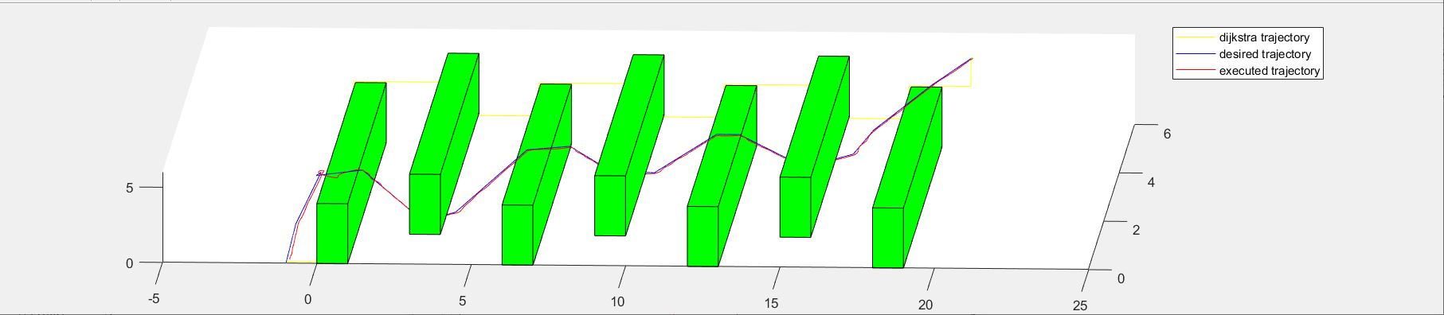
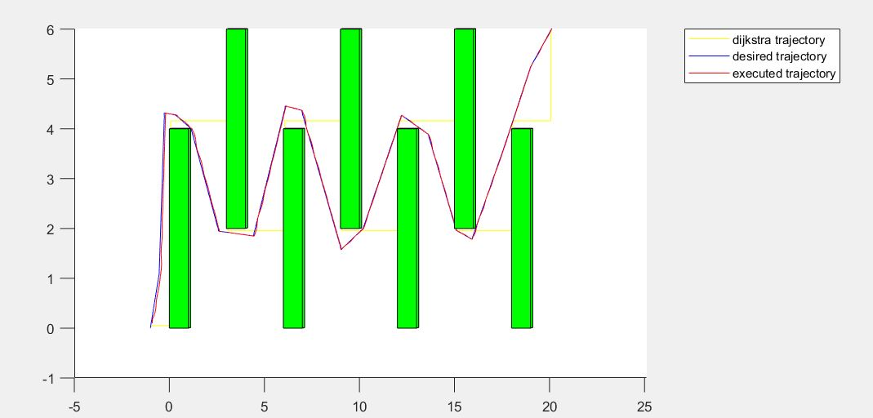
Results
theoretical shortest distance: 29.90
our method: 33.74
Q

Slide 9
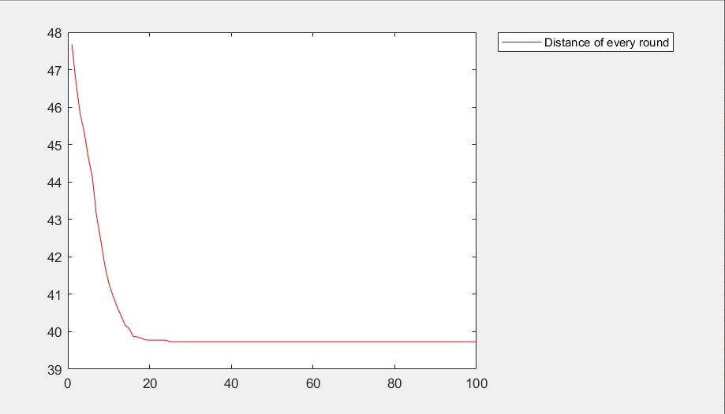
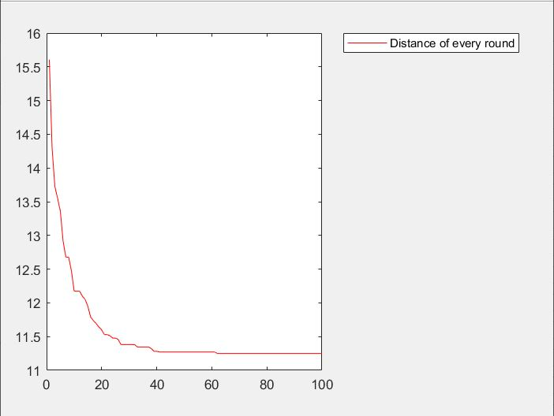
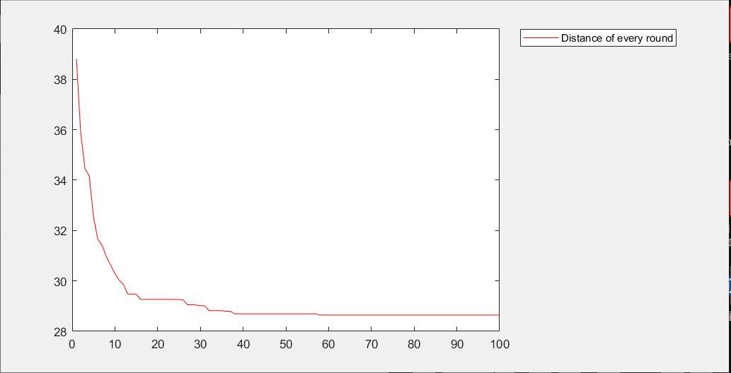
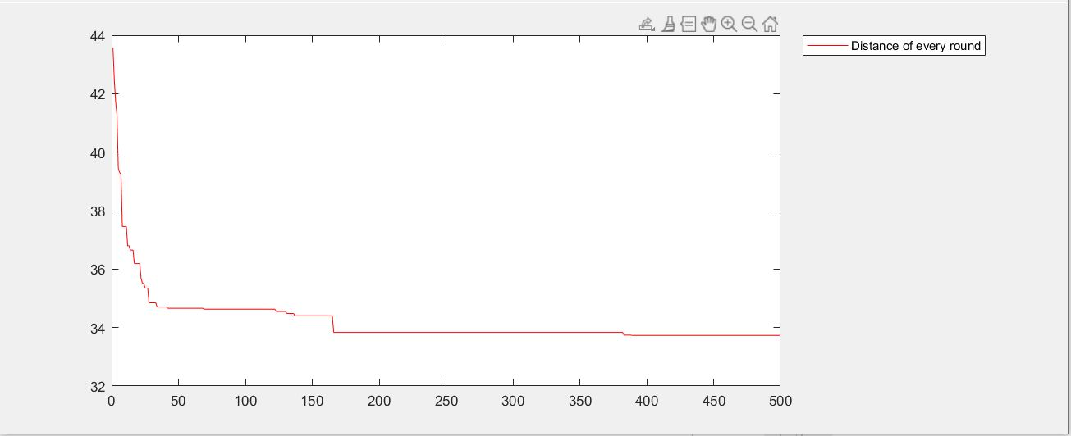
Results
Plots of Total Distance in each CEM iteration
map0
map1
map2
map3
Q

Slide 10
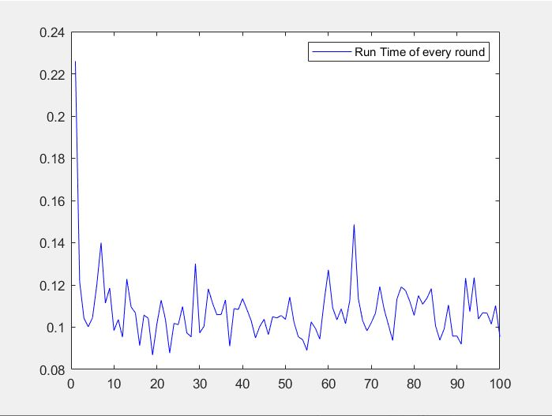
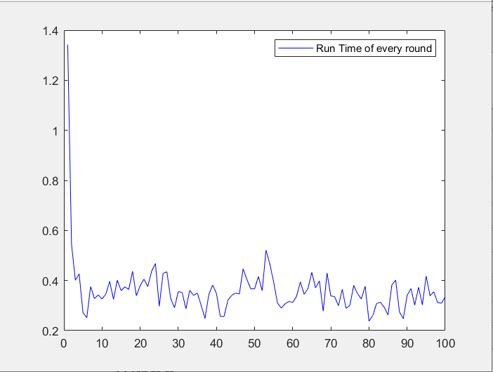
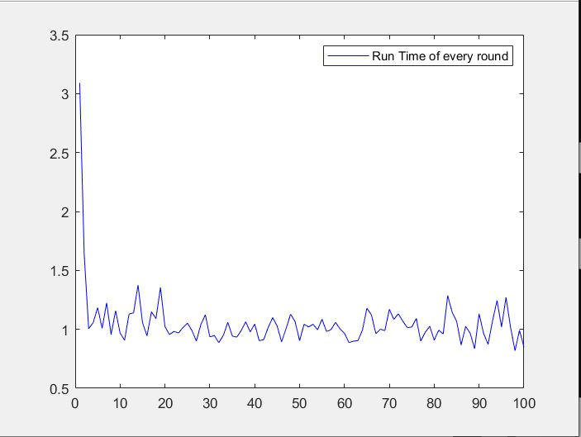
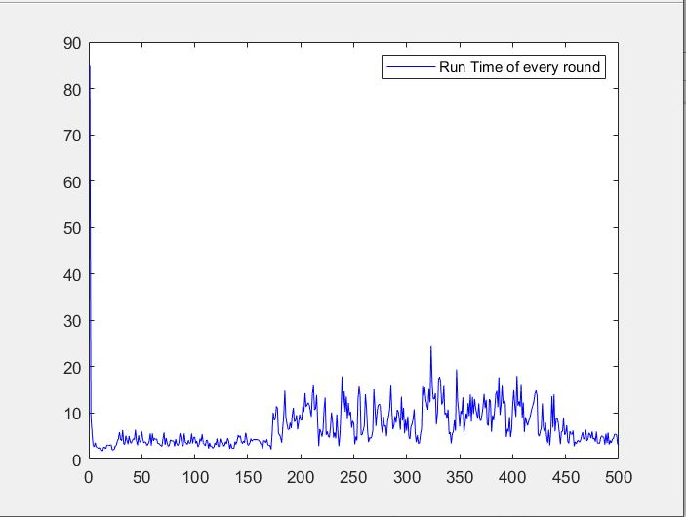
Results
Plots of Run Time in each CEM iteration
map0
map1
map2
map3
Q

Slide 11
Questions?
Model
Our Method
Trajectory generation
Controller
Equation of Motion
Results
Minimum Jerk

Slide 12
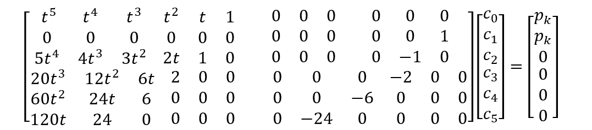
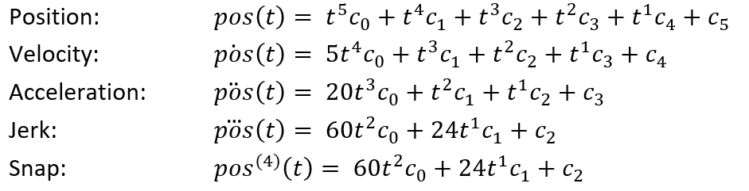
We used minimum jerk segments methods to generate the trajectory.
Segment k at pk
Segment k+1 at pk
Q

Slide 13
Reference
https://alliance.seas.upenn.edu/~meam620/wiki/index.php

